Slide 1
Big Data Frameworks
Mohammad A. Hoque

Slide 2
Course Overview
This course examines the current emerging Big Data Frameworks with focus on System and Applications.
We begin with an overview on Big data and machine learning preliminaries.
Then we emphasize Berkeley Data Analysis Stack - Spark,
Spark Programming Model
Distributed File System and Scheduling,
Streaming, and machine learning.

Slide 3
General Info
Advanced Course, 5 credits
Course components
Lectures
Assignments
Reading list
Exam
Team
Mohammad A. Hoque, Dr. Eemil Lagerspetz, Prof. Sasu Tarkoma.

Slide 4
Lectures
Lectures (Not Mandatory)
Tuesdays 12-14 in C222, 14.3 – 04.05
Exercise Sessions (Not Mandatory)
Thursday 10-12 in C222, 16.03 – 04.05
Course Exam
Yet to announce
Optional Exam
Yet to announce

Slide 5
Exam Materials
Lectures & Reading List
Resilient Distributed Datasets: A Fault-Tolerant Abstraction for In-Memory Cluster Computing
http://static.usenix.org/events/nsdi11/tech/full_papers/Hindman_new.pdf
HaLoop: Efficient Iterative Data Processing on Large Clusters
MLbase: A Distributed Machine-learning System.
Tachyon: Reliable, Memory Speed Storage for Cluster Computing Frameworks
The dataflow model: a practical approach to balancing correctness, latency, and cost in massive-scale, unbounded, out-of-order data processing
Discretized Stream processing at scale.

Slide 6
Grading
Course grading will be based on the final exam and the assignments/exercises
Exam 60% and Assignments 40% of the grade
Exam Date: Yet to announce

Slide 7
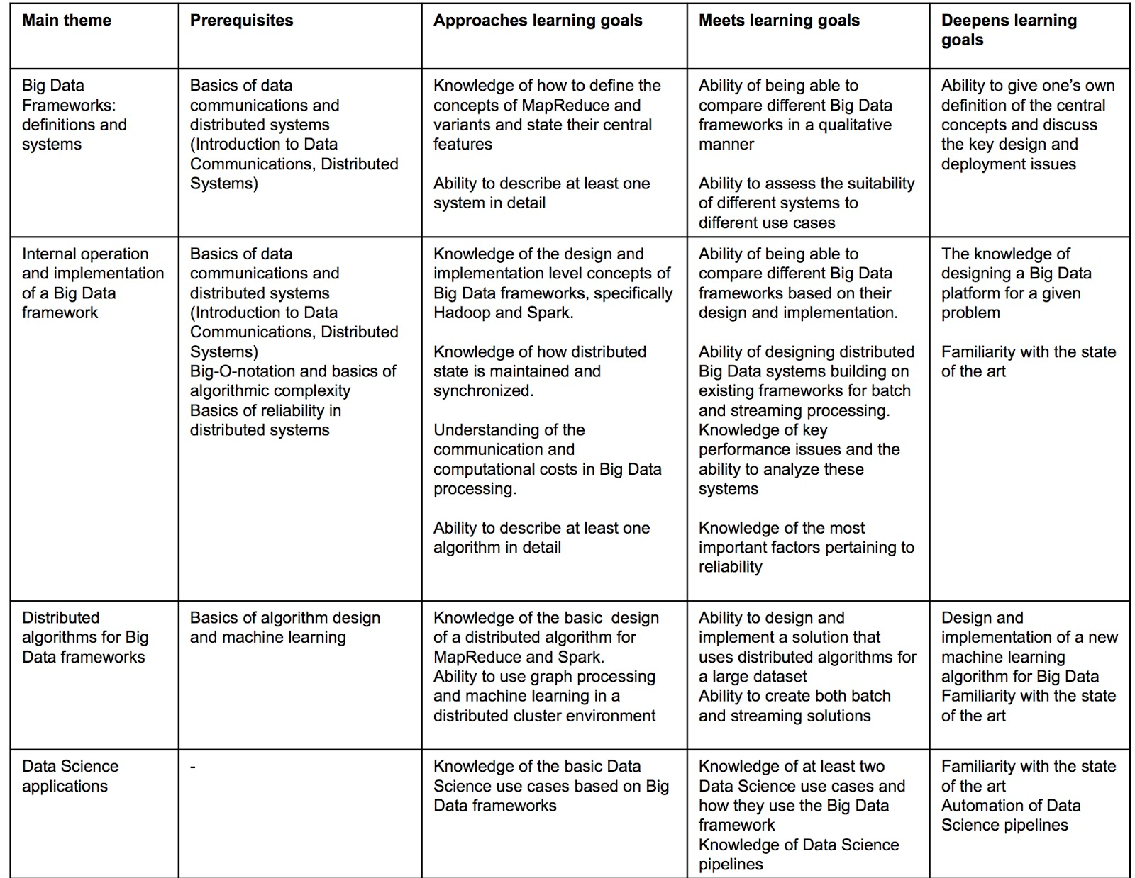
Prof. Sasu Tarkoma

Slide 8




Overview
Notes:
http://creativecommons.org/licenses/by-nc-sa/4.0/

Slide 9
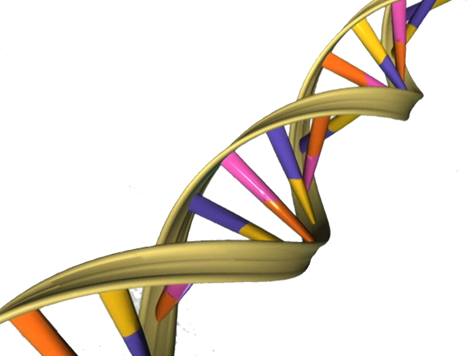





Rapid growth of massive datasets
E.g., Online activity, Science, Sensor networks
Data
Notes:
all images from wikipedia (public domain license) or pixabay unless otherwise noted
Big Data in Today’s Business and Technology Environment
2.7 Zetabytes of data exist in the digital universe today. (Source)
235 Terabytes of data has been collected by the U.S. Library of Congress in April 2011. (Source)
IDC Estimates that by 2020,business transactions on the internet- business-to-business and business-to-consumer – will reach 450 billion per day. (Source)
Facebook stores, accesses, and analyzes 30+ Petabytes of user generated data. (Source)
Akamai analyzes 75 million events per day to better target advertisements. (Source)
Walmart handles more than 1 million customer transactions every hour, which is imported into databases estimated to contain more More than 5 billion people are calling, texting, tweeting and browsing on mobile phones worldwide. (Source)
Decoding the human genome originally took 10 years to process; now it can be achieved in one week. (Source)
In 2008, Google was processing 20,000 terabytes of data (20 petabytes) a day. (Source)
The largest AT&T database boasts titles including the largest volume of data in one unique database (312 terabytes) and the second largest number of rows in a unique database (1.9 trillion), which comprises AT&T’s extensive calling records. (Source)
The Rapid Growth of Unstructured Data
YouTube users upload 48 hours of new video every minute of the day. (Source)
571 new websites are created every minute of the day. (Source)
Brands and organizations on Facebook receive 34,722 Likes every minute of the day. (Source)
100 terabytes of data uploaded daily to Facebook. (Source)
According to Twitter’s own research in early 2012, it sees roughly 175 million tweets every day, and has more than 465 million accounts. (Source)
30 Billion pieces of content shared on Facebook every month. (Source)
Data production will be 44 times greater in 2020 than it was in 2009. (Source)
In late 2011, IDC Digital Universe published a report indicating that some 1.8 zettabytes of data will be created that year. (Source)
In other words, the amount of data in the world today is equal to:
Every person in the US tweeting three tweets per minute for 26,976 years.
Every person in the world having more than 215m high-resolution MRI scans a day.
More than 200bn HD movies – which would take a person 47m years to watch.

Slide 10
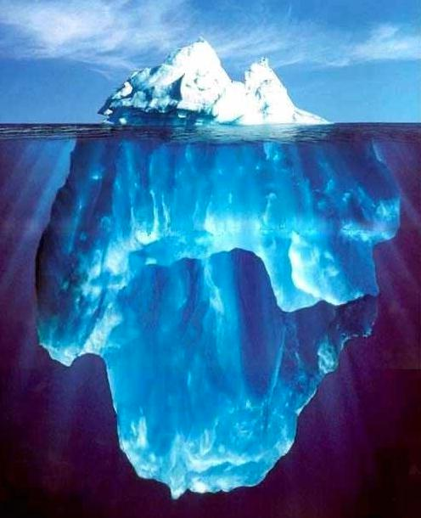
Where Does Big Data Come From?
It’s all happening online – could record every:
Click
Ad impression
Billing event
Fast Forward, pause,…
Server request
Transaction
Network message
Fault
…

Slide 11
Where Does Big Data Come From?
User Generated Content (Web & Mobile)
Facebook
Instagram
Yelp
TripAdvisor
Twitter
YouTube
…

Slide 12
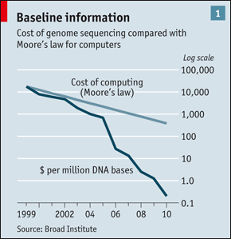
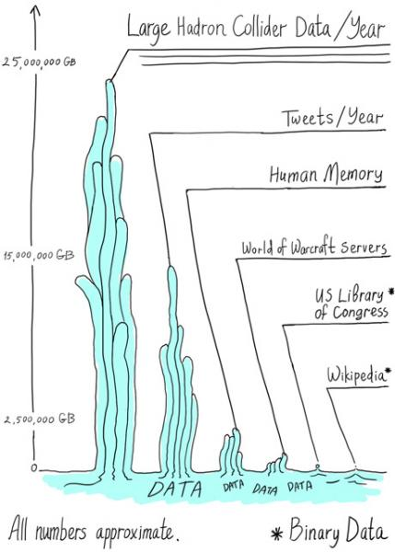
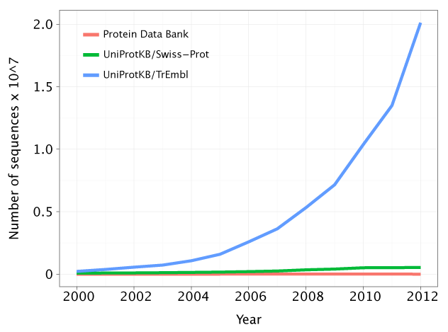
Where Does Big Data Come From?
Health and Scientific Computing
Images: http://www.economist.com/node/16349358
http://gorbi.irb.hr/en/method/growth-of-sequence-databases/
http://www.symmetrymagazine.org/article/august-2012/particle-physics-tames-big-data
Notes:
http://www.economist.com/node/16349358
http://gorbi.irb.hr/en/method/growth-of-sequence-databases/
http://www.symmetrymagazine.org/article/august-2012/particle-physics-tames-big-data

Slide 13
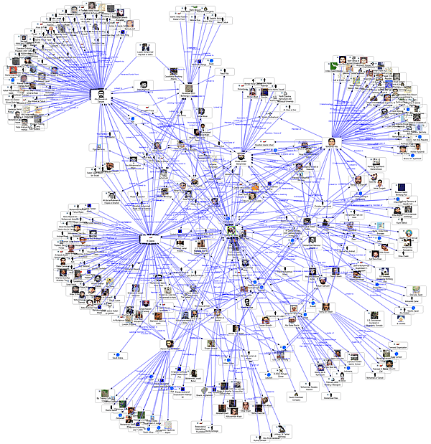
Graph Data
Lots of interesting data has a graph structure:
Social networks
Telecommunication Networks
Computer Networks
Road networks
Collaborations/Relationships
…
Some of these graphs can get quite large (e.g., Facebook user graph)

Slide 14
Log Files – Apache Web Server Log
uplherc.upl.com - - [01/Aug/1995:00:00:07 -0400] "GET / HTTP/1.0" 304 0 uplherc.upl.com - - [01/Aug/1995:00:00:08 -0400] "GET /images/ksclogo-medium.gif HTTP/1.0" 304 0 uplherc.upl.com - - [01/Aug/1995:00:00:08 -0400] "GET /images/MOSAIC-logosmall.gif HTTP/1.0" 304 0 uplherc.upl.com - - [01/Aug/1995:00:00:08 -0400] "GET /images/USA-logosmall.gif HTTP/1.0" 304 0 ix-esc-ca2-07.ix.netcom.com - - [01/Aug/1995:00:00:09 -0400] "GET /images/launch-logo.gif HTTP/1.0" 200 1713 uplherc.upl.com - - [01/Aug/1995:00:00:10 -0400] "GET /images/WORLD-logosmall.gif HTTP/1.0" 304 0 slppp6.intermind.net - - [01/Aug/1995:00:00:10 -0400] "GET /history/skylab/skylab.html HTTP/1.0" 200 1687 piweba4y.prodigy.com - - [01/Aug/1995:00:00:10 -0400] "GET /images/launchmedium.gif HTTP/1.0" 200 11853 tampico.usc.edu - - [14/Aug/1995:22:57:13 -0400] "GET /welcome.html HTTP/1.0" 200 790

Slide 15
Machine Syslog File
dhcp-47-129:CS100_1> syslog -w 10
Feb 3 15:18:11 dhcp-47-129 Evernote[1140] <Warning>: -[EDAMAccounting read:]: unexpected field ID 23 with type 8. Skipping.
Feb 3 15:18:11 dhcp-47-129 Evernote[1140] <Warning>: -[EDAMUser read:]: unexpected field ID 17 with type 12. Skipping.
Feb 3 15:18:11 dhcp-47-129 Evernote[1140] <Warning>: -[EDAMAuthenticationResult read:]: unexpected field ID 6 with type 11. Skipping.
Feb 3 15:18:11 dhcp-47-129 Evernote[1140] <Warning>: -[EDAMAuthenticationResult read:]: unexpected field ID 7 with type 11. Skipping.
Feb 3 15:18:11 dhcp-47-129 Evernote[1140] <Warning>: -[EDAMAccounting read:]: unexpected field ID 19 with type 8. Skipping.
Feb 3 15:18:11 dhcp-47-129 Evernote[1140] <Warning>: -[EDAMAccounting read:]: unexpected field ID 23 with type 8. Skipping.
Feb 3 15:18:11 dhcp-47-129 Evernote[1140] <Warning>: -[EDAMUser read:]: unexpected field ID 17 with type 12. Skipping.
Feb 3 15:18:11 dhcp-47-129 Evernote[1140] <Warning>: -[EDAMSyncState read:]: unexpected field ID 5 with type 10. Skipping.
Feb 3 15:18:49 dhcp-47-129 com.apple.mtmd[47] <Notice>: low priority thinning needed for volume Macintosh HD (/) with 18.9 <= 20.0 pct free space

Slide 16
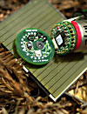

Internet of Things: Example Measurements
36meters
33m: 111
32m: 110
30m: 109,108,107
20m: 106,105,104
10m: 103, 102, 101
Redwood tree humidity and temperature at various heights

Slide 17
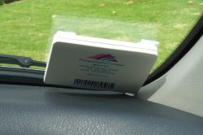
Internet of Things: RFID tags
California FasTrak Electronic Toll Collection transponder
Used to pay tolls
Collected data also used for traffic reporting
http://www.511.org/
http://en.wikipedia.org/wiki/FasTrak
Notes:
http://en.wikipedia.org/wiki/FasTrak

Slide 18
Fish Farms

Slide 19
What is Machine Learning?

Slide 20
A Definition
Constructing and studying methods that learn from and make predictions on data
Broad area involving tools and ideas from various domains
Computer Science
Probability and Statistics
Optimization
Linear Algebra

Slide 21



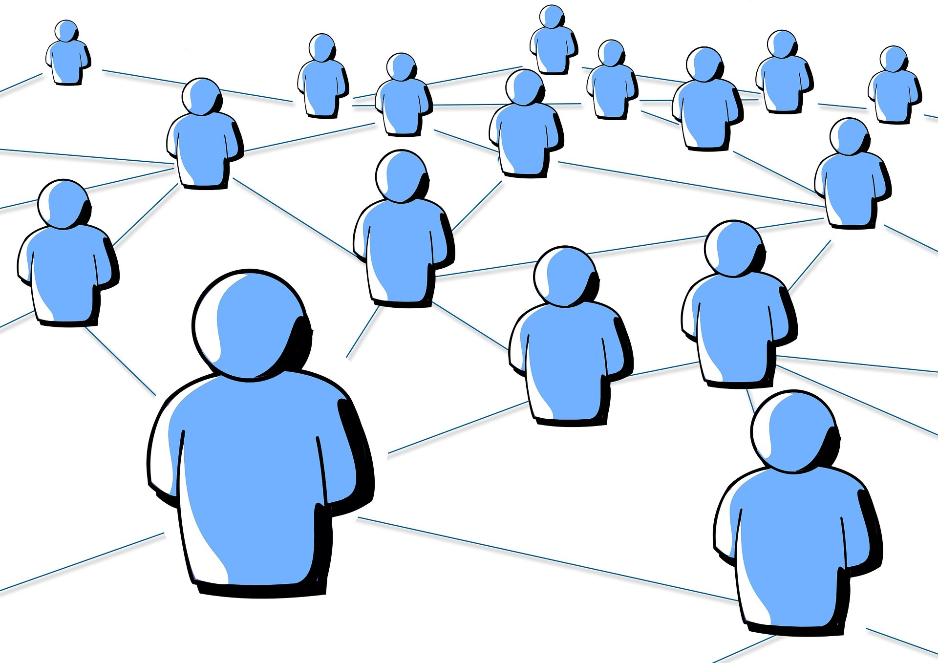

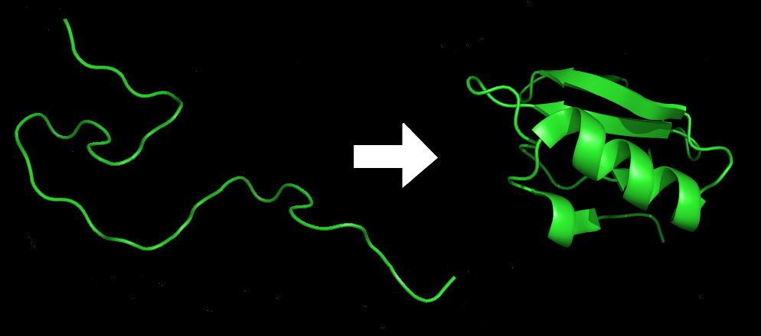
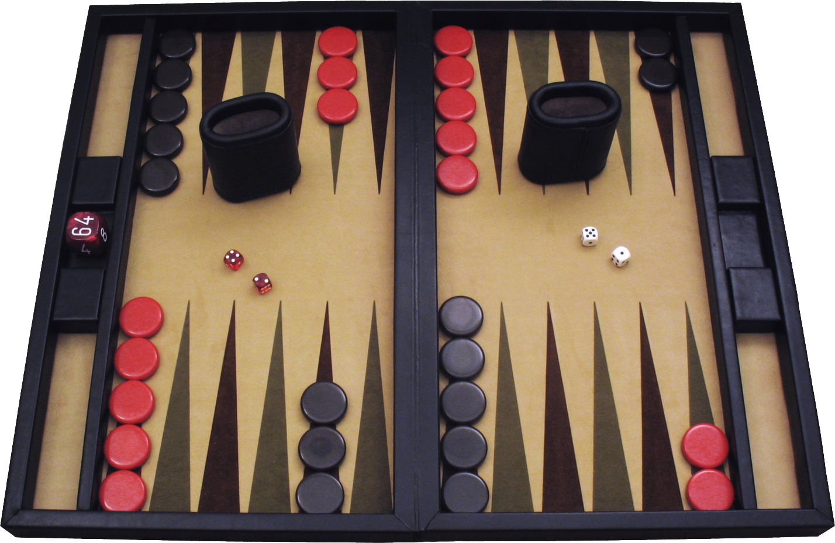
Some Examples
Face recognition
Link prediction
Text or document classification, e.g., spam detection
Protein structure prediction
Games, e.g., Backgammon or Jeopardy

Slide 22
Terminology
Observations. Items or entities used for learning or evaluation, e.g., emails
Features. Attributes (typically numeric) used to represent an observation, e.g., length, date, presence of keywords
Labels. Values / categories assigned to observations, e.g., spam, not-spam
Training and Test Data. Observations used to train and evaluate a learning algorithm, e.g., a set of emails along with their labels
Training data is given to the algorithm for training
Test data is withheld at train time

Slide 23
Two Common Learning Settings
Supervised learning. Learning from labeled observations
Labels ‘teach’ algorithm to learn mapping from observations to labels
Unsupervised learning. Learning from unlabeled observations
Learning algorithm must find latent structure from features alone
Can be goal in itself (discover hidden patterns, exploratory data analysis)
Can be means to an end (preprocessing for supervised task)

Slide 24
Examples of Supervised Learning
Classification. Assign a category to each item, e.g., spam detection
Categories are discrete
Generally no notion of ‘closeness’ in multi-class setting
Regression. Predict a real value for each item, e.g., stock prices
Labels are continuous
Can define ‘closeness’ when comparing prediction with label

Slide 25
Examples of Unsupervised Learning
Clustering. Partition observations into homogeneous regions, e.g., to identify “communities” within large groups of people in social networks
Dimensionality Reduction. Transform an initial feature representation into a more concise representation, e.g., representing digital images

Slide 26
Typical Supervised Learning Pipeline

Slide 27
Obtain Raw Data
Raw data comes from many sources

Slide 28
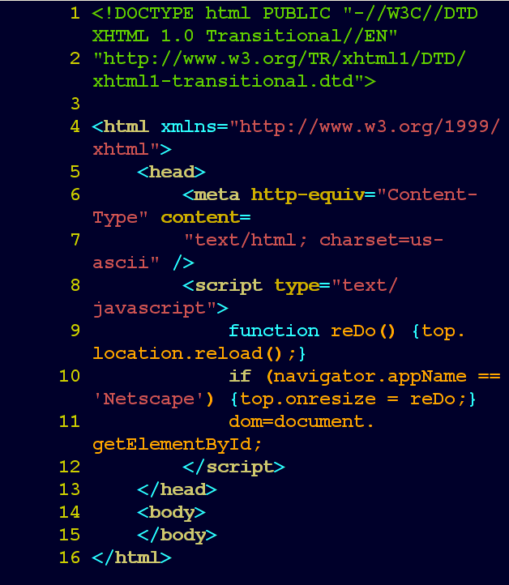
Data Types
Web hypertext

Slide 29
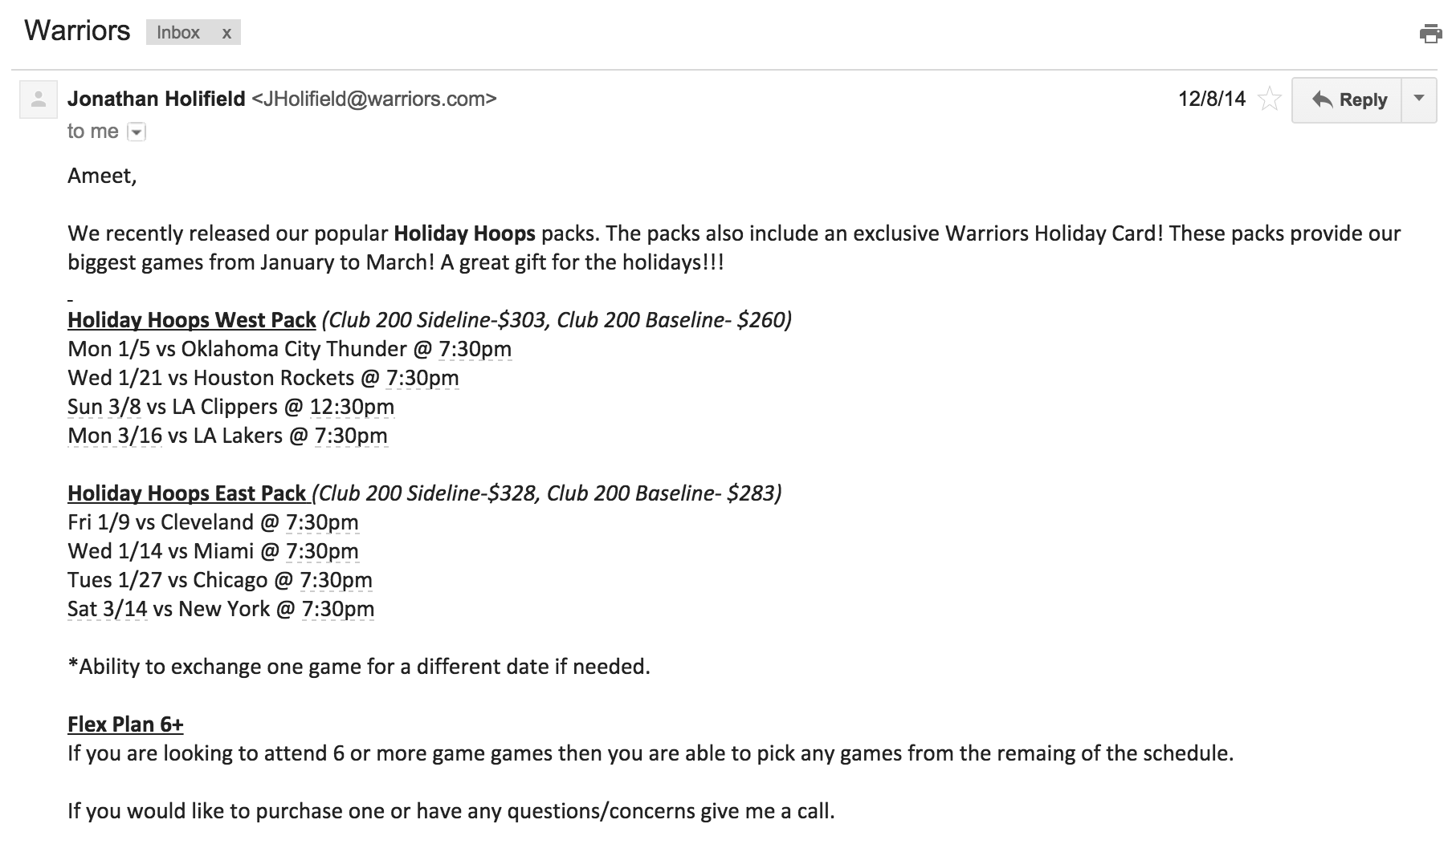
Data Types
Email

Slide 30
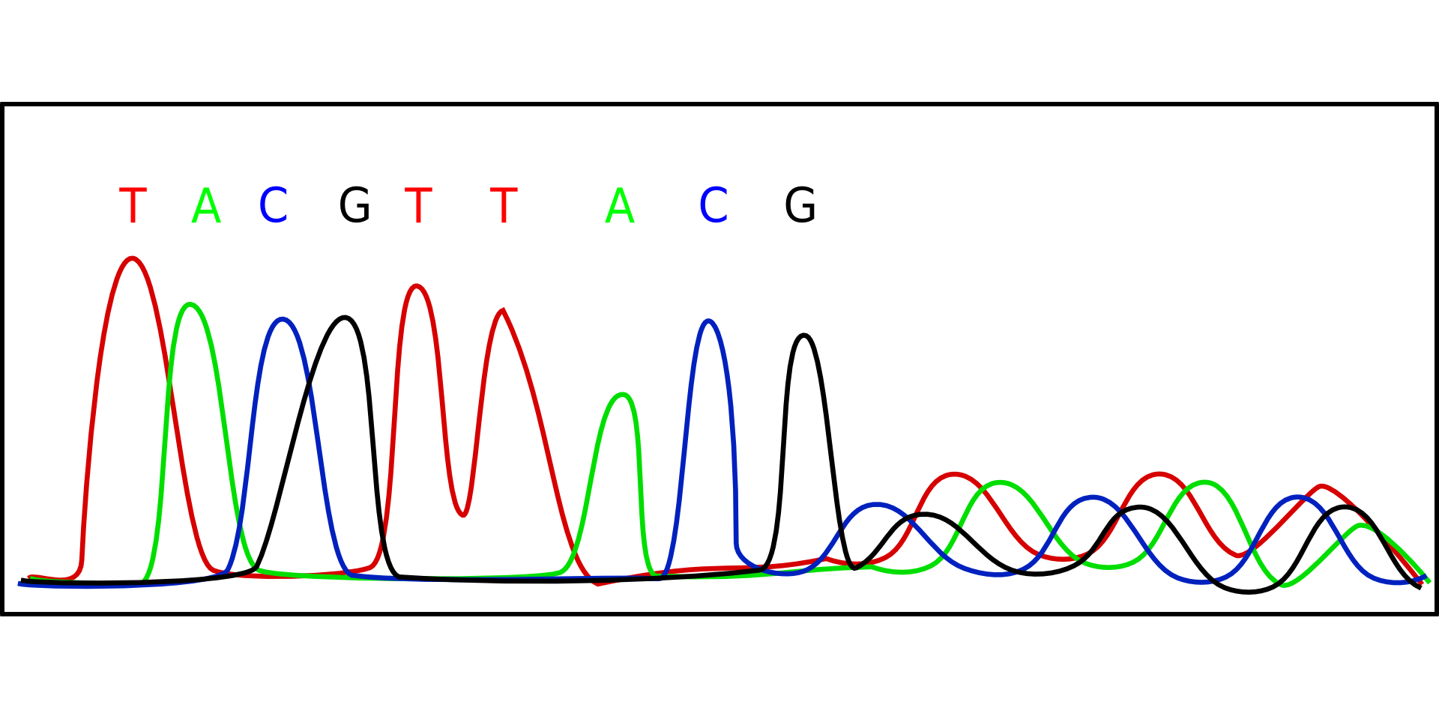
Data Types
Genomic Data, e.g., SNPs

Slide 31
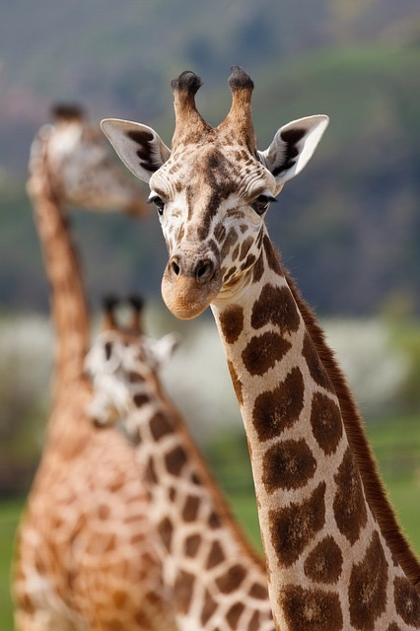



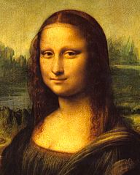

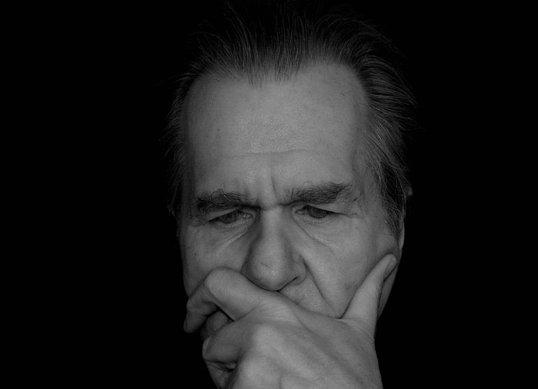



Data Types
Images

Slide 32
Data Types
(Social) Networks / Graphs

Slide 33

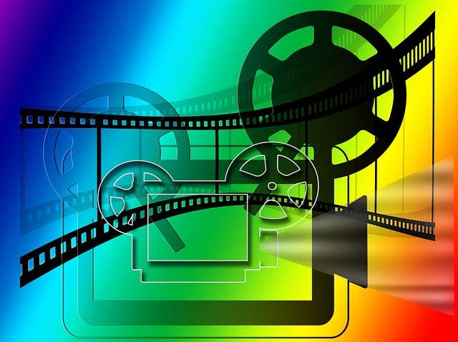







Data Types
User Ratings

Slide 34
Obtain Raw Data
Initial observations can be in arbitrary format
We extract features to represent observations
We can incorporate domain knowledge
We typically want numeric features
Success of entire pipeline often depends on choosing good descriptions of observations!!
Feature Extraction
Notes:
Useful even when original data is already numeric

Slide 35
Obtain Raw Data
Feature Extraction
Unsupervised Learning
Preprocessing step for supervised learning

Slide 36
Obtain Raw Data
Train a supervised model using labeled data, e.g., Classification or Regression model
Feature Extraction
Supervised Learning

Slide 37

Obtain Raw Data
Q: How do we determine the quality of the model we’ve just trained?
A: We can evaluate it on test / hold-out data, i.e., labeled data not used for training
If we don’t like the results, we iterate…
Feature Extraction
Supervised Learning
Evaluation

Slide 38
Obtain Raw Data
Feature Extraction
Once we’re happy with our model, we can use it to make predictions on future observations, i.e., data without a known label
Supervised Learning
Evaluation
Predict

Slide 39




Distributed Clusters are Pervasive
Data
Distributed Computing

Slide 40
Mature Methods for Common Problems e.g., classification, regression, collaborative filtering, clustering
Machine
Learning
Data
Distributed Computing

Slide 41
ML is Applied Everywhere
E.g., Personalized recommendations, Speech recognition, Face detection, Protein structure, Fraud detection, Spam filtering, Playing chess or Jeopardy, Unassisted vehicle control, Medical diagnosis, ...
Machine
Learning
Data
Distributed Computing

Slide 42
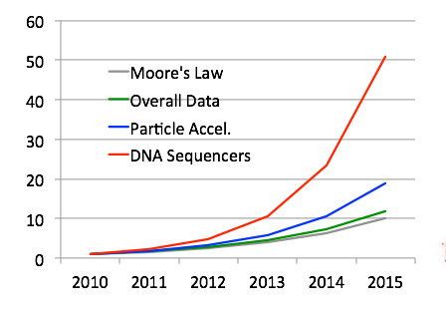
Challenge: Scalability
Classic ML techniques are not always suitable for modern datasets
Data Grows Faster than Moore’s Law
[IDC report, Kathy Yelick, LBNL]
Machine
Learning
Data
Distributed Computing

Slide 43
Distributed Computing and Apache Spark

Slide 44
How to Handle Massive Data?
Traditional tools (Matlab, R, Excel, etc.) run on a single machine
Notes:
e.g., petabyte sort record; speed on disk due to implementation details, including faster shuffles

Slide 45
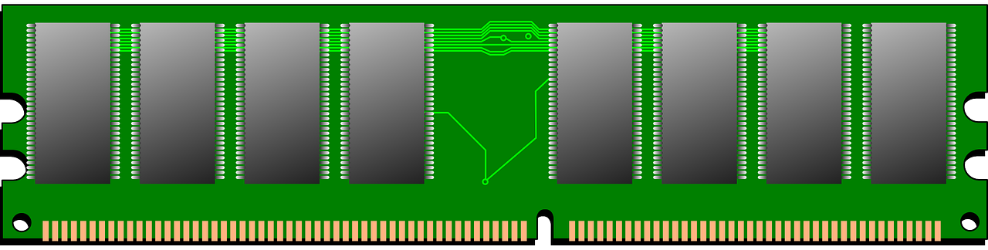
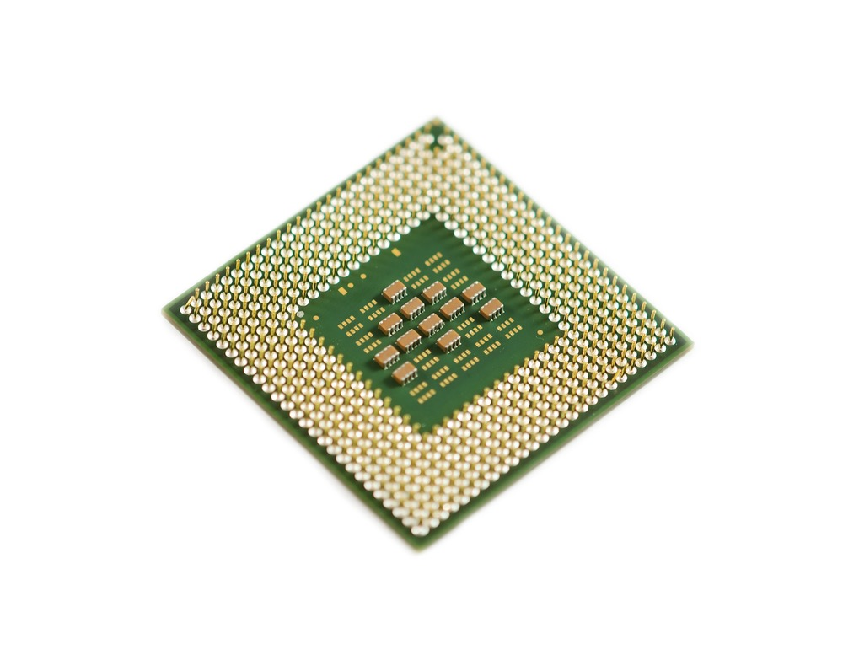

How to Handle Massive Data?
Need more hardware to store / process modern data
Scale-up (one big machine)
Can be very fast for medium scale problems
Expensive, specialized hardware
Eventually hit a wall
RAM
CPU
RAM
Disk
CPU
Disk

Slide 46
How to Handle Massive Data?
Need more hardware to store / process modern data
Scale-out (distributed, e.g., cloud-based)
Commodity hardware, scales to massive problems
Need to deal with network communication
Added software complexity
Network
RAM
RAM
RAM
RAM
…
CPU
CPU
CPU
CPU
Disk
Disk
Disk
Disk

Slide 47



What is Apache ?
General, open-source cluster computing engine
Well-suited for machine learning
Fast iterative procedures
Efficient communication primitives
Simple and Expressive
APIs in Scala, Java, Python, R
Interactive Shell
Integrated Higher-Level Libraries
Spark SQL
Spark
Streaming
MLlib
GraphX
Apache Spark

